Slide 1


석사학위논문심사 발표자료
Application of comparative genomics
for reference genome quality improvement evaluation and evolutionary analysis
ㅑ
- 참조유전체 품질 개선 평가 및 진화 분석을 위한 비교유전체학의 적용 -
Interdisciplinary Program in Bioinformatics, Master program
2018-28812
Juwan Kim
Supervised by Prof. Heebal Kim
BIOPOP: Lab. of Bioinformatics and Population Genetics

Slide 2
Contents
General introduction
Chapter 1: Literature review
Chapter 2: False gene and chromosome losses affected by assembly and sequence errors
Chapter 3: Genetic adaptations in mudskipper and tetrapod give insights into their convergent water-to-land transition
General discussion

Slide 3
General introduction

Slide 4

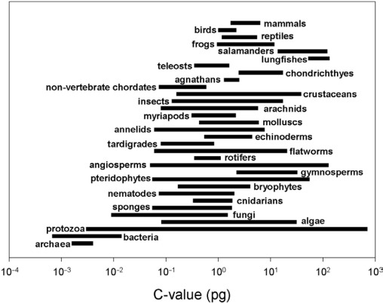
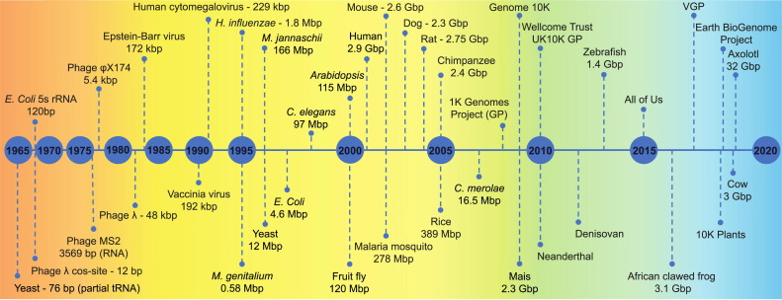
General introduction
General introduction
Comparative genomics: Comparative analyses in which the genomic features of different organisms are compared
Aims: Understanding the genetic basis for commonalities and differences between different species by identifying structural and functional genomic elements conserved across different species
Vertebrate genomes: relatively large and including long repeats (LINE, LTR, tandem repeats…)
Vertebrate genome sequencing: Initiating from the end of the twentieth century
Human genome project (1990~2003)
Currently: +400 annotated vertebrate genomes in NCBI
➔ Enabling diverse applications of comparative genomics
Concept of comparative genomics
Genome size distribution of diverse clades
History of genome sequencing project (Giani et al., 2020)
Giani, A. M., Gallo, G. R., Gianfranceschi, L., & Formenti, G. (2020). Long walk to genomics: History and current approaches to genome sequencing and assembly. Computational and structural biotechnology journal, 18, 9-19.

Slide 5
Chapter 1. Literature review

Slide 6

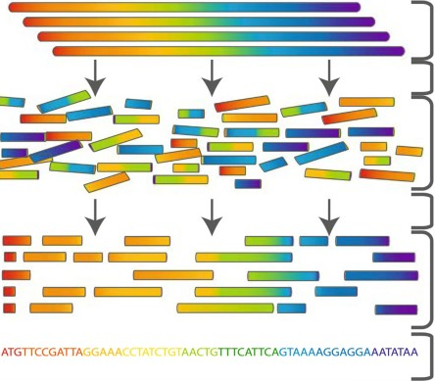
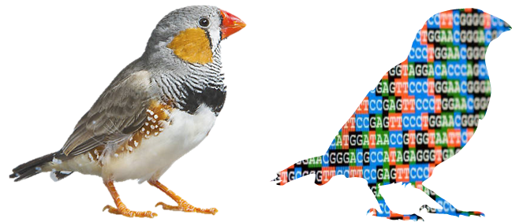
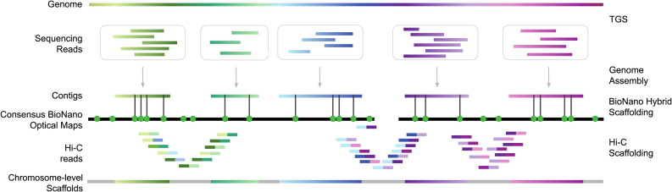
Chapter 1. Literature review
1.1. Reference genome
Definition:
Digital nucleic acid sequence database, assembled by scientists as a representative example of the set of genes in one idealized individual organism of a species
Usage:
Reference information of all set of genes, population genomics, comparative genomics…
How to produce?:
DNA sequences
Factors affecting assembly quality:
Sequencing platforms
Genome size
Sample quality
Assembly algorithm
…
Producing reads and contigs
Scaffolding
Final genome assembly
Summary of assembling genome sequences
Reference genome assembly:
representing the set of genes of a species
Pipeline to produce a high-quality genome assembly with various techniques (Giani et al., 2020)
Giani, A. M., Gallo, G. R., Gianfranceschi, L., & Formenti, G. (2020). Long walk to genomics: History and current approaches to genome sequencing and assembly. Computational and structural biotechnology journal, 18, 9-19.

Slide 7




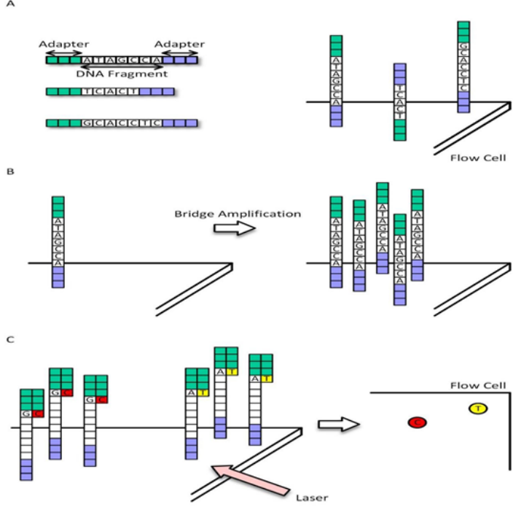
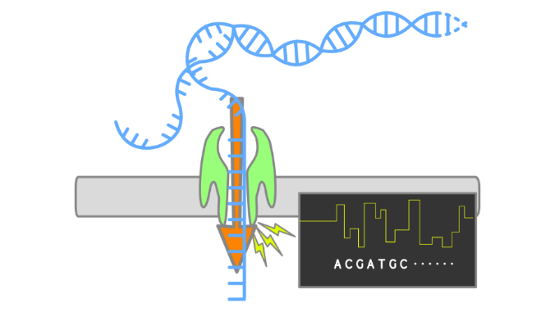
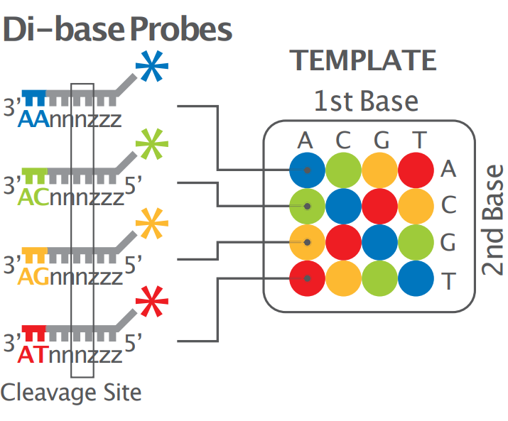
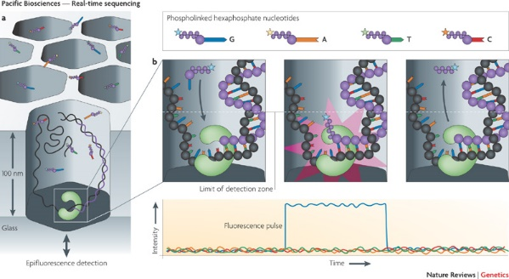





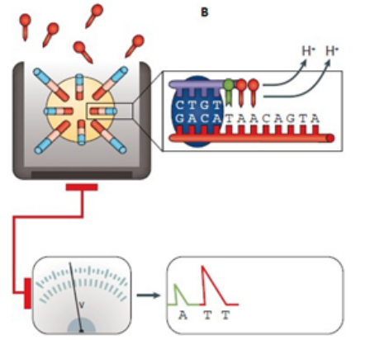
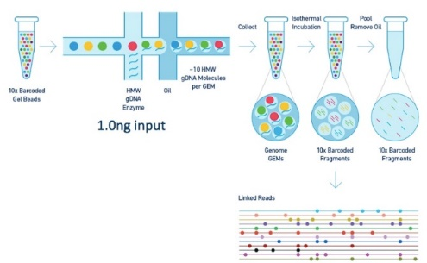
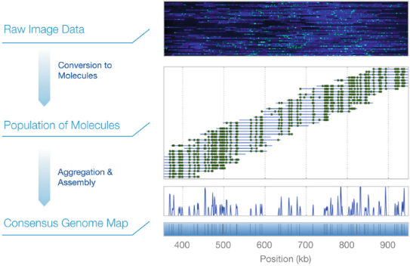
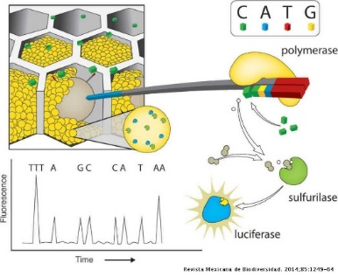
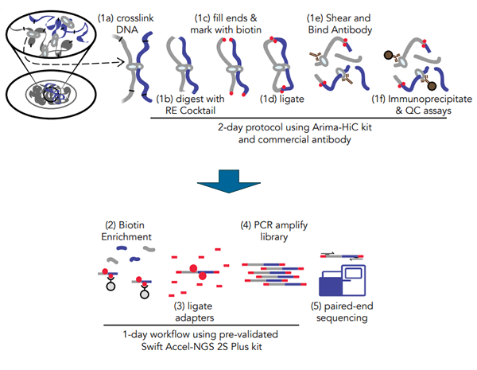
Chapter 1. Literature review
1.2. Long-read and long-range technologies
Short read-length platforms
Long-read sequencing
Long read
Long-range sequencing
Long range

Slide 8
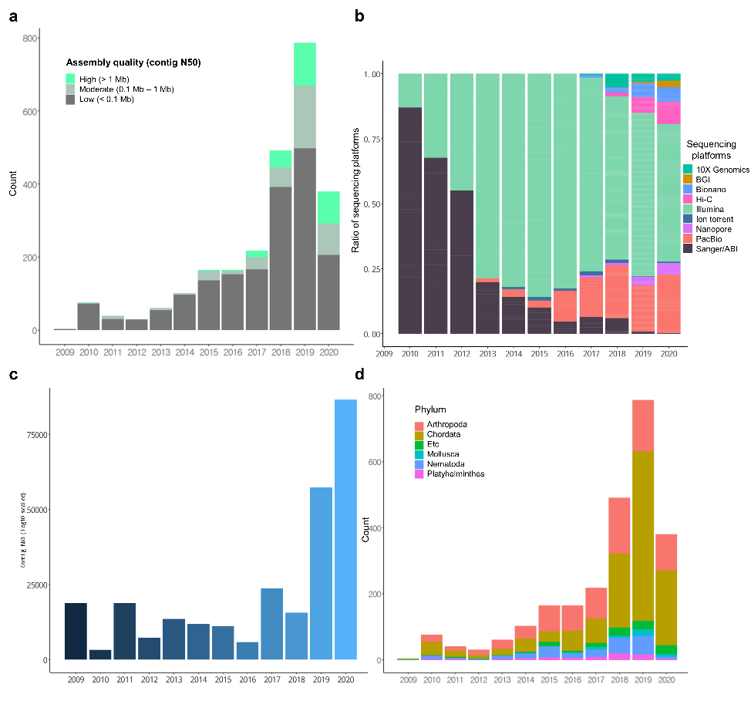

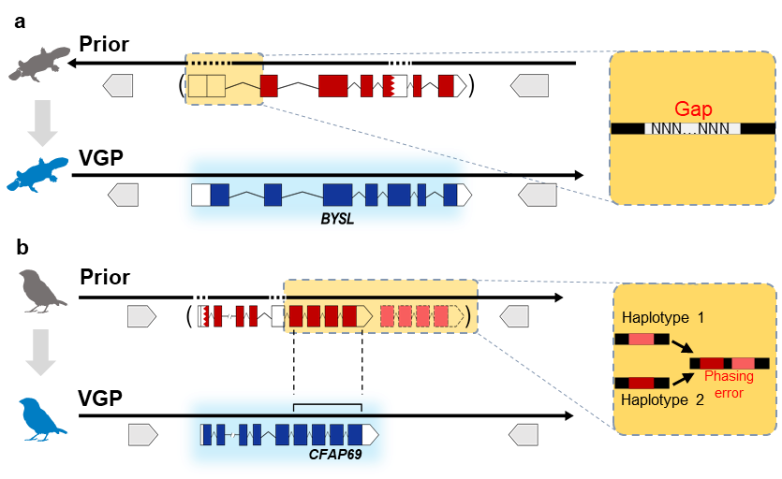
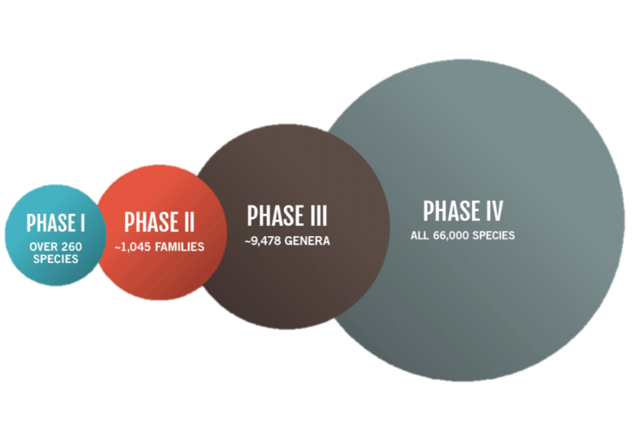


Chapter 1. Literature review
1.3. Recent trends in sequencing animal genomes
Usage of long-read and long-range technologies: effectively improve assembly quality
Trends in animal genome assemblies: Larger number, long-read & long-range based, and more contiguous
Global genome project: High-quality assemblies in a large scale (e.g. VGP, EBP…)
Example cases of BUSCO genes affected by assembly errors in the prior assembly of platypus and zebra finch.
Assembly statistics of animal genome in NCBI assembly database (~2020)
Example of global genome projects

Slide 9
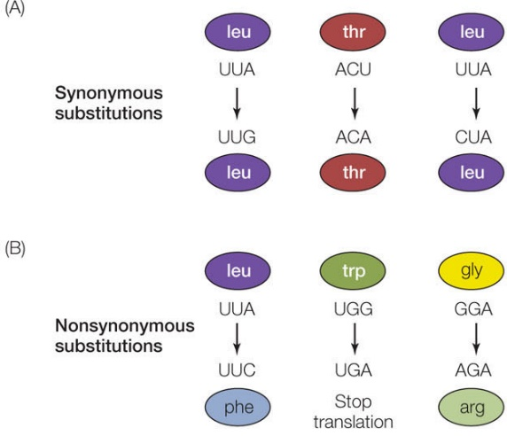
Chapter 1. Literature review
1.4. Comparative genomics methods
Genome-wide alignment
Comparative annotation
Comparative genomics: Comparative analyses in which the genomic features of different organisms are compared
Principle: commonalities and differences between the two organisms are based on the conserved and diverged sequences of homologous regions
Methods:
Genome-wide alignment
Comparative annotation
Gene family analysis
dN/dS analysis
…
Genome
A
B
Gene family analysis
dN/dS analysis
Genome
A
B

Slide 10
Chapter 2. False gene and chromosome losses
affected by assembly and sequence errors
This chapter will be published in elsewhere
as a partial fulfillment of Juwan Kim’s Master program.

Slide 11
Chapter 2. False gene and chromosome losses affected by assembly and sequence errors
VGP
2.1. Introduction
Genome assemblies with varying completeness:
Human and a few model organisms: BAC cloning and manual sequencing
Most of other organisms: Generated from cost-effective next generation sequencing (NGS) platforms with shorter read length (Sanger: ~1kbp; Illumina: ~200bp)
Problems: Low contiguity; missing sequences; base calling errors…
Vertebrate Genomes Project (VGP):
Aims: Generation of error-free, chromosome-level genome assemblies of all extant vertebrates
Technology: Generation of contigs with long-read sequencing (PacBio CLR)
+ Scaffolding with long-range information:
(1) Linked-reads from 10X Genomics
(2) Optical maps from Bionano Genomics
(3) Hi-C reads from Arima Genomics
Quality improvement: ~635 fold in contiguity,
Deeper evaluation in gene structure improvement and recovery of missing sequences was necessary.

Slide 12
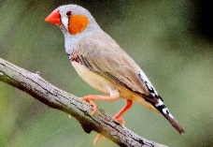
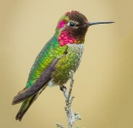
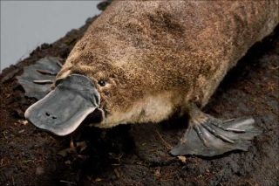
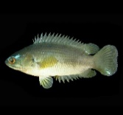
Chapter 2. False gene and chromosome losses affected by assembly and sequence errors
VGP
2.2. Materials and methods
Genome alignment and analysis on the missing genomic regions:
Raw data: VGP and prior genome assembly of 4 species
(1) Reference-free alignment: cactus
(2) Reference-based alignment: minimap2
Missing ratio and false indel/SNP ratio analysis:
Consecutive 100bp windows from upstream/downstream 3kbp
Classification of exons & introns: 5’-UTR, 1st coding exon, internal coding exon, last coding exon, 3’-UTR
False indel/SNP: Variant-calling from variation graph from cactus alignment + excluding ~2bp of potential heterozygous or VGP erroneous sequences
Classification and detection of false gene loss candidates:
Eight type of false gene loss:
(1) Structure: completely missing / missing exon / fragmented / translocation
(2) Sequence: frameshift / premature stop codon / splicing junction disruption / Ns in the CDS
Projection of annotation: Comparative Annotation Toolkits
Discovery of VGP missing regions:
Identification of prior-specific regions
Investigation of the longest missing sequences
Calculation GC and repeat content: Using updated VGP trio-based assembly
Zebra finch
Anna’s
hummingbird
Platypus
Climbing
perch

Slide 13
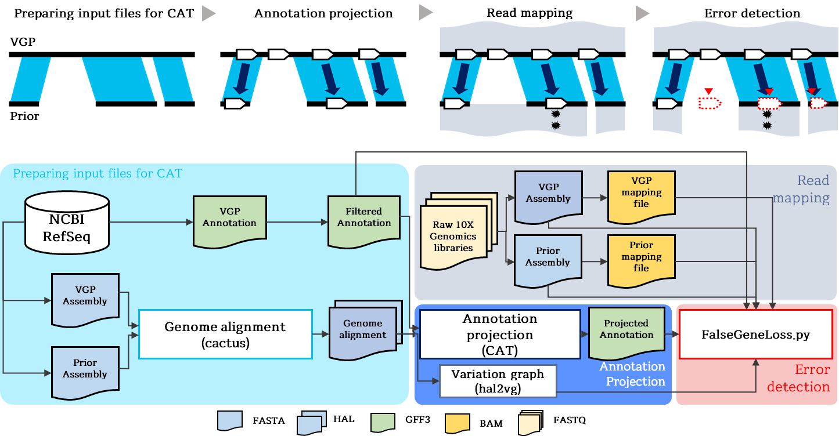
Chapter 2. False gene and chromosome losses affected by assembly and sequence errors
VGP
2.2. Materials and methods
Notes:
Our classification of false gene loss is mainly based on the result generated by the program CAT, comparative annotation toolkit.
(CAT is the program to project annotation data from a reference to target assemblies based on genomic alignment done by cactus.
Even though it’s main purpose is between-species analysis, we think that CAT can be also utilized to project VGP annotation to previous assembly as well. )
So, the VGP and previous assemblies were aligned with cactus, and then CAT was used to project annotation from VGP to previous assembly.
Finally, we compared CAT and original VGP annotation in order to detect false gene loss.
Instead of using all transcripts of the VGP annotation, the longest transcript of each gene was used as a representative transcript to simplify the result.
We have analyzed 4 species, platypus, zebra finch, tiger fugu and climbing perch. VGP assembly & annotation of each species were used as a reference. For platypus and zebra finch, two previous assemblies based on sanger and pacbio were analyzed in order to check the effect of sequencing platform on the amount of false gene loss. And for fishes, Sanger assembly for fugu and illumine assembly for climbing perch were used as a target assembly.

Slide 14
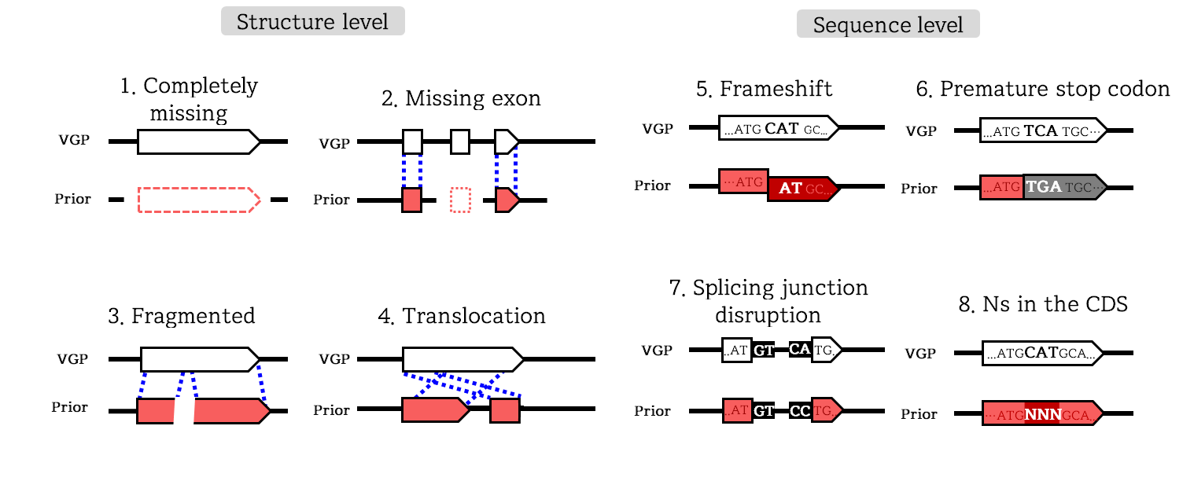
Chapter 2. False gene and chromosome losses affected by assembly and sequence errors
VGP
2.2. Materials and methods

Slide 15
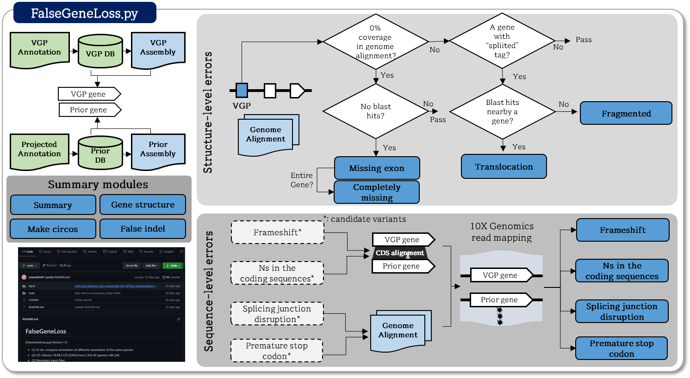
Chapter 2. False gene and chromosome losses affected by assembly and sequence errors
VGP
2.2. Materials and methods

Slide 16
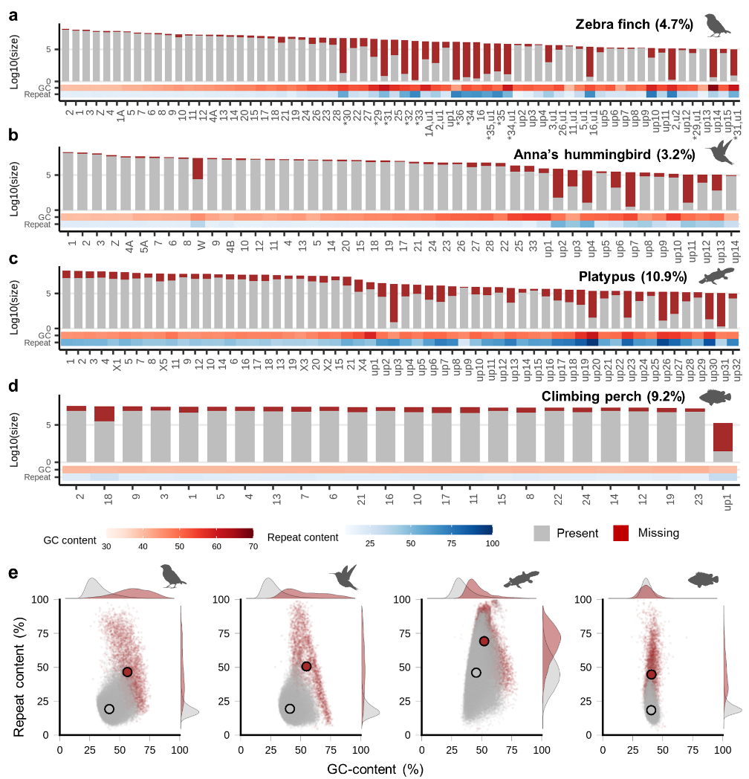
Chapter 2. False gene and chromosome losses affected by assembly and sequence errors
VGP
2.3.1. Previously missing genomic regions have higher GC- and repeat content.
(1) Amount of missing sequences
Sanger-based: Zebra finch & Platypus
Illumina-based: Anna’s hummingbird & Climbing perch
Missing ratio:
Depending on species: ~3.2% to ~10.9%
Depending on chromosome-level scaffolds: ~1.2 to ~96.7%
(2) GC and repeat content of missing sequences
Zebra finch, Anna’s hummingbird, and platypus: Higher GC and repeat content of missing regions compared to the present sequences
Climbing perch did not show higher GC content in the missing regions unlike other species, which was consistent with greater sequence homogeneity of fish genomes compared to tetrapods.
Proportion, GC-content, and repeat content of missing genomic regions in prior assemblies found in VGP assemblies.

Slide 17
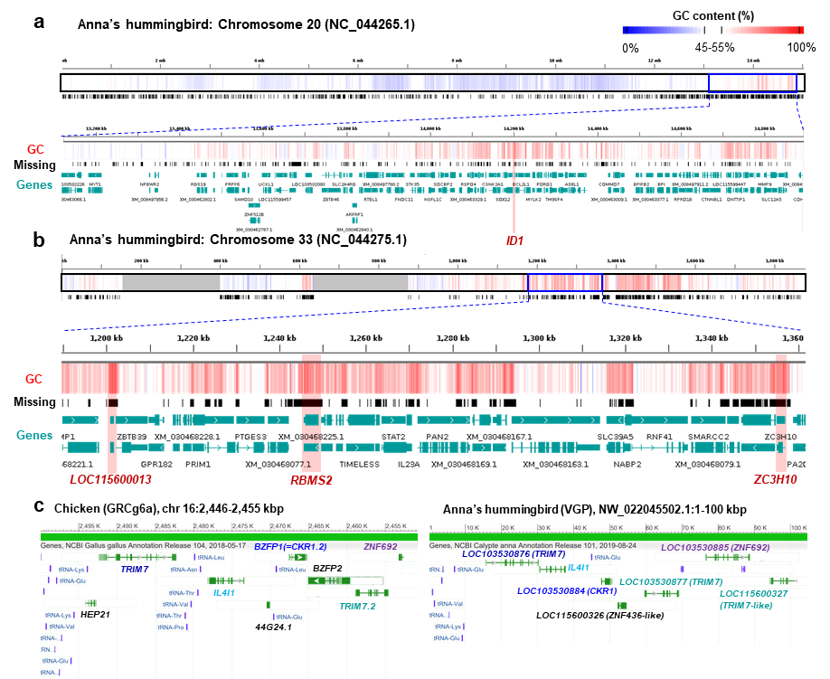
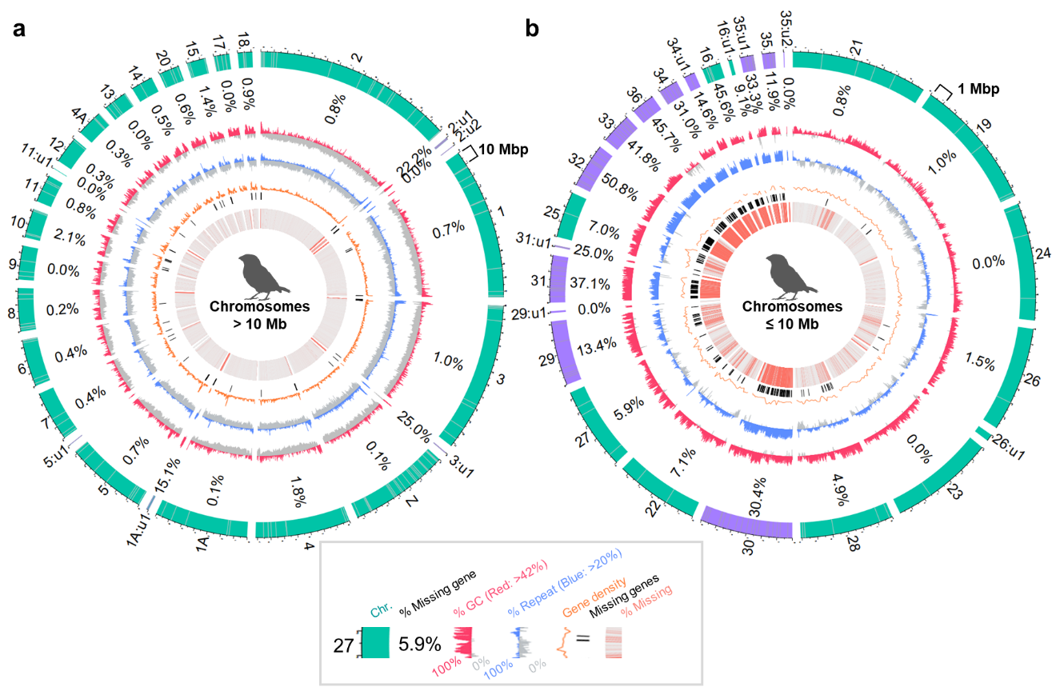
Chapter 2. False gene and chromosome losses affected by assembly and sequence errors
VGP
2.3.2. Newly identified chromosomes are high in gene density.
Zebra finch microchromosomes 29~36 were newly identified:
- Microchromosomes with high GC content, gene density, and high missing ratio resulted in 575 of completely missing genes
Anna’s hummingbird: GC-rich segments with high missing ratio
Circos plots revealing chromosome profiles of previously missing protein coding genes recovered in the VGP zebra finch assembly.
Missing sequences in Anna’s hummingbird assembly.

Slide 18
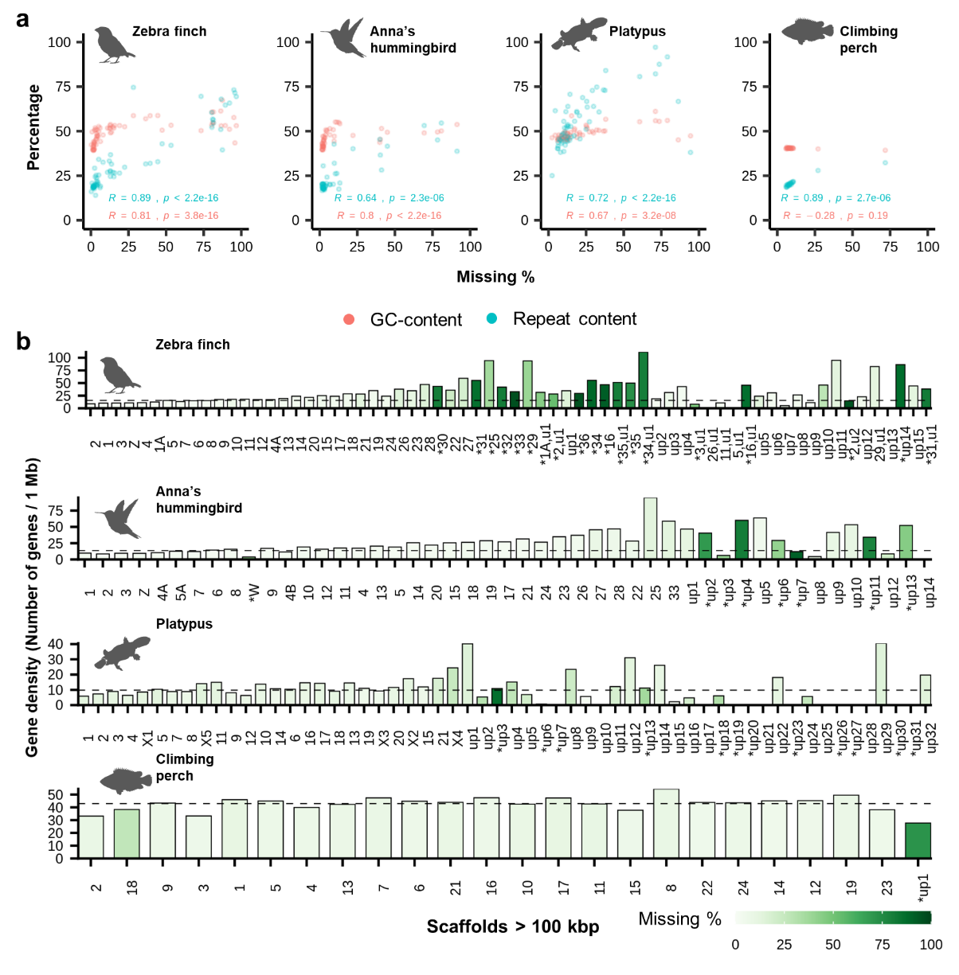
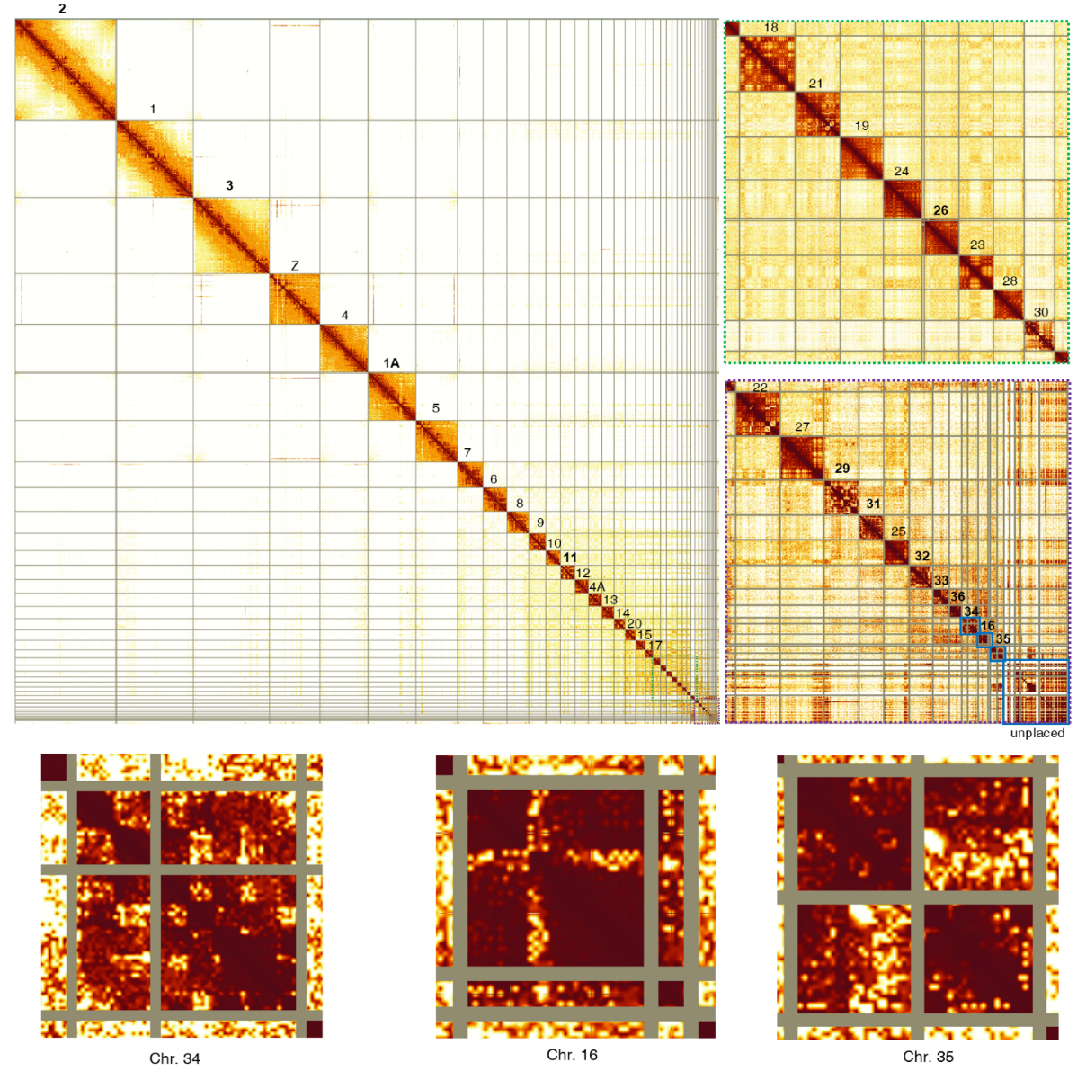
Chapter 2. False gene and chromosome losses affected by assembly and sequence errors
VGP
2.3.2. Newly identified chromosomes are high in gene density.
Association between missing ratio, GC- or repeat content, and gene density of VGP assemblies.
Hi-C interaction heatmap of the VGP zebra finch reassembly (by Kerstin Howe, Jonathan Wood)

Slide 19
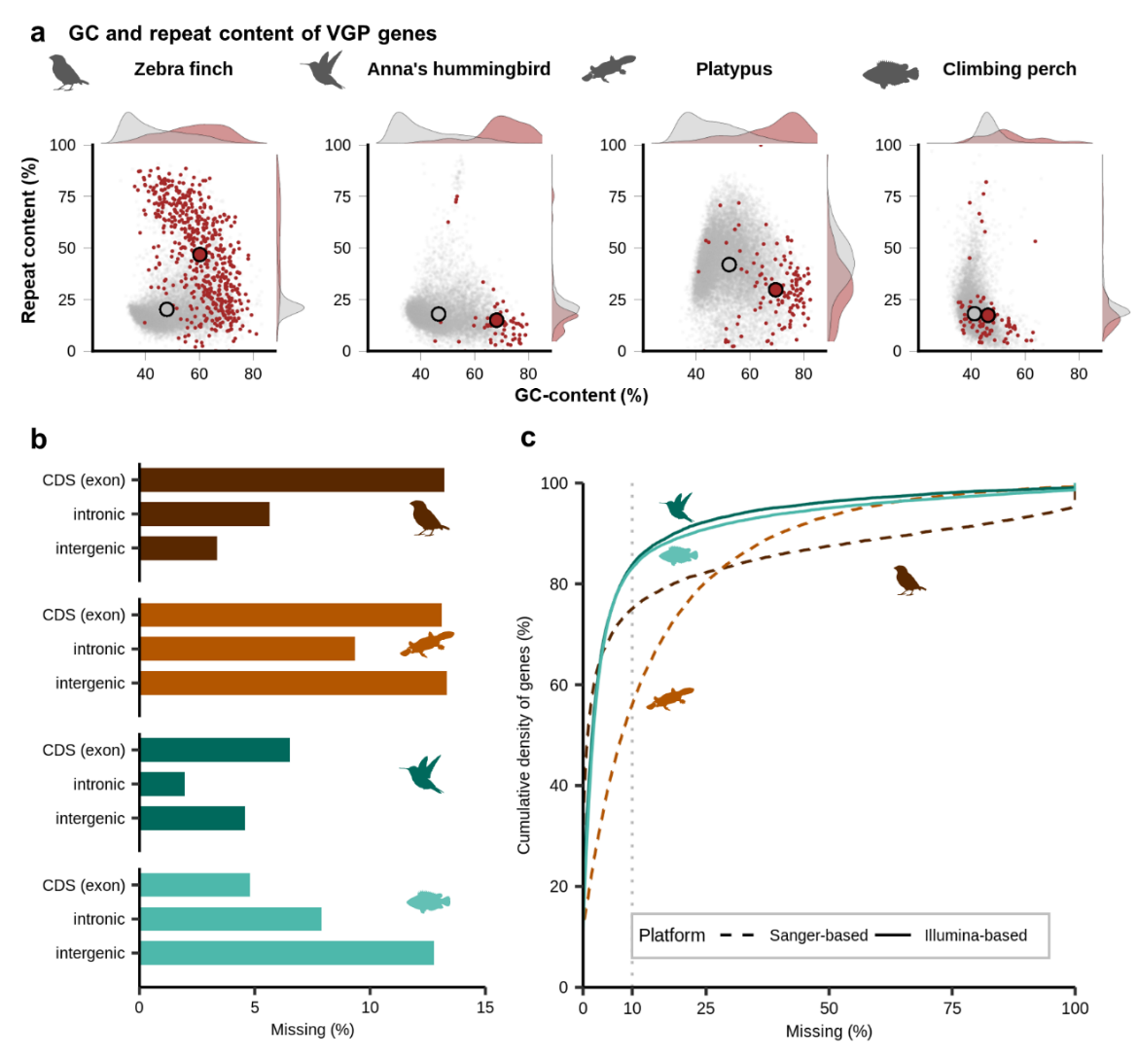
Chapter 2. False gene and chromosome losses affected by assembly and sequence errors
VGP
2.3.3. Bias of missing sequence in coding, lncRNA, and their regulatory regions
(1) GC and repeat content of VGP genes
Completely missing genes: Higher GC content compared to the rest genes
(2) Amount of missing sequences in VGP genes
~5 to ~13% of exon & intron regions
Sequencing platform differences:
Illumina-based assemblies: ~83% of genes were well assembled (<10% of missing ratio)
Sanger-based assemblies: 55~70% of genes were well assembled
(3) Number of missing exons: up to ~20,000
Number of missing exons in the previous assemblies.
Species |  |  | Zebra finch | Anna’s hummingbird | Platypus | Climbing perch
Total |  |  | 13,781 | 8,221 | 20,132 | 3,479
Included in completely missing genes? | Yes |  | 3,695 | 141 | 354 | 178
 | No |  | 10,086 | 8,080 | 19,778 | 3,301
Exon position | 5'UTR |  | 2,818 | 5,402 | 4,868 | 567
 | Coding exon | First | 2,170 | 4,150 | 3,876 | 445
 |  | Internal | 9,679 | 1,602 | 13,206 | 2,395
 |  | Last | 816 | 190 | 1,046 | 274
 | 3'UTR |  | 783 | 120 | 952 | 251
Amount and characteristics of missing genes and exons.

Slide 20
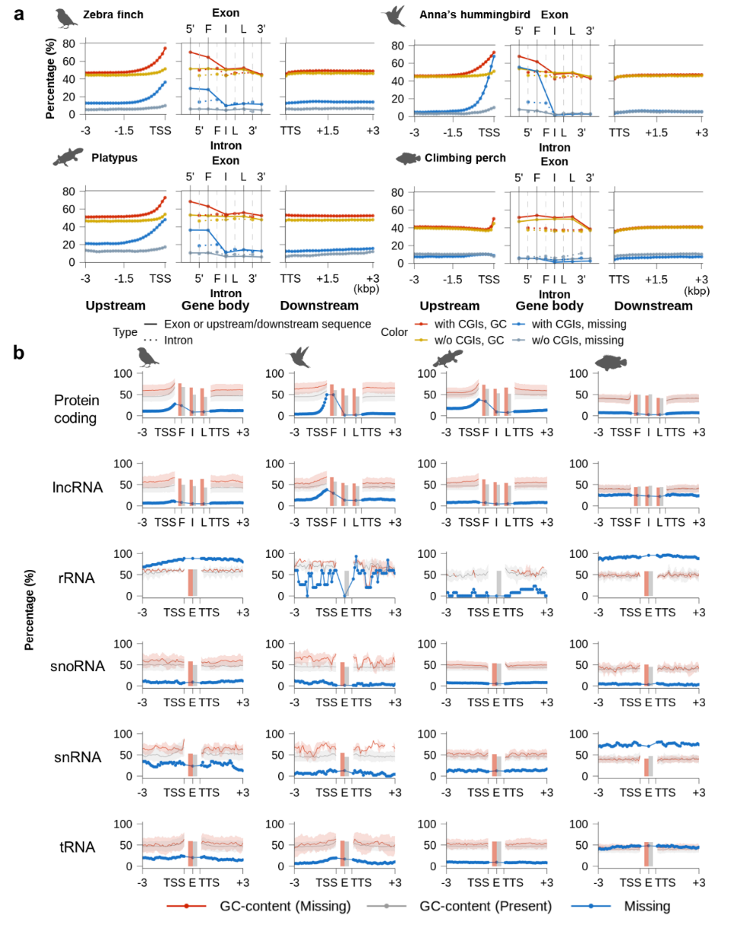
Chapter 2. False gene and chromosome losses affected by assembly and sequence errors
VGP
2.3.3. Bias of missing sequence in coding, lncRNA, and their regulatory regions (continued)
(4) Missing ratio and GC-content near coding genes (birds, platypus)
Upstream sequences: High GC-content & missing ratio near TSS
Gene body: Higher GC-content & missing ratio near 5’ proximal exons
Downstream sequences: No fluctuation
* Genes with upstream CpG islands: Higher missing ratio & GC-content
Distribution of missing sequences and GC-content within or near genes in previous assemblies relative to VGP assemblies.

Slide 21
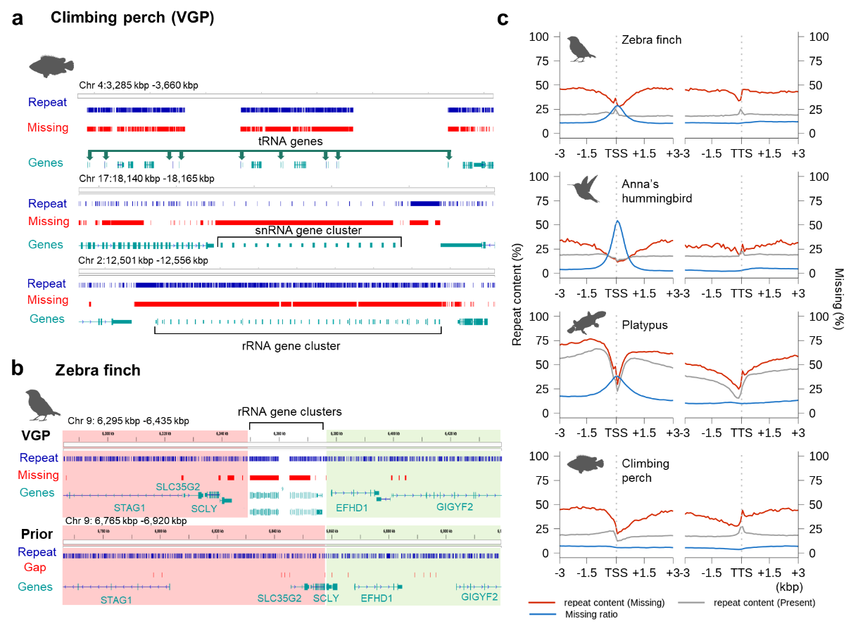
Chapter 2. False gene and chromosome losses affected by assembly and sequence errors
VGP
2.3.3. Bias of missing sequence in coding, lncRNA, and their regulatory regions (continued)
(5) Distribution of missing sequences and GC content in all genes
Zebra finch, Anna’s hummingbird, and platypus: Biased missing ratio on GC-rich 5’ proximal regions of protein coding and lncRNA genes
Missing ratio of rRNA and tRNA of climbing perch: Associated with high repeat content
Distribution of missing sequences and GC-content within or near genes in previous assemblies relative to VGP assemblies.
Repeat profile of previously missing genomic regions.

Slide 22
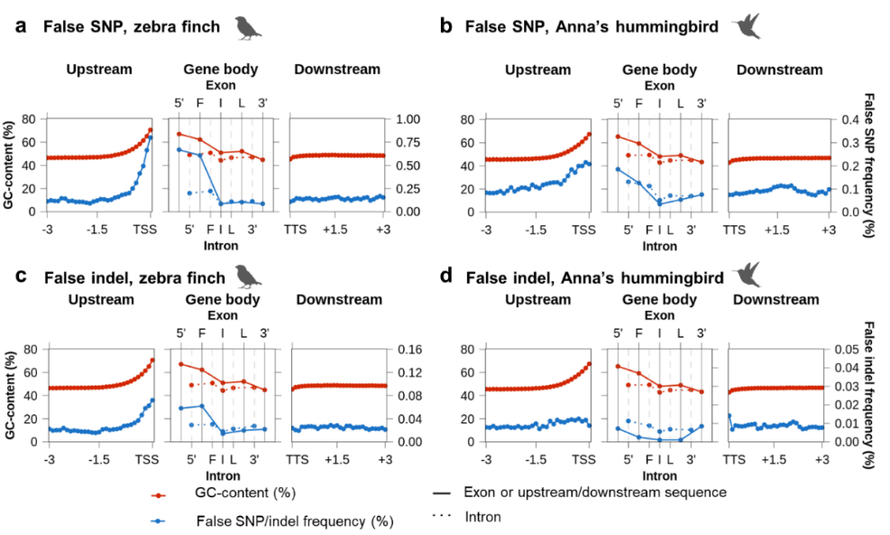
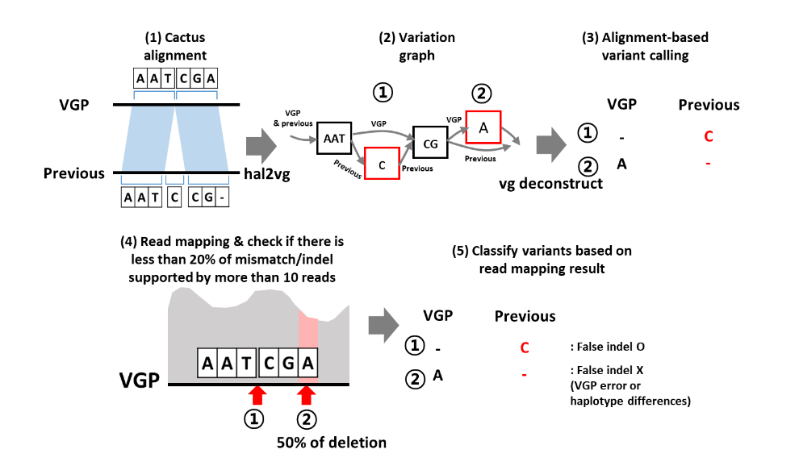
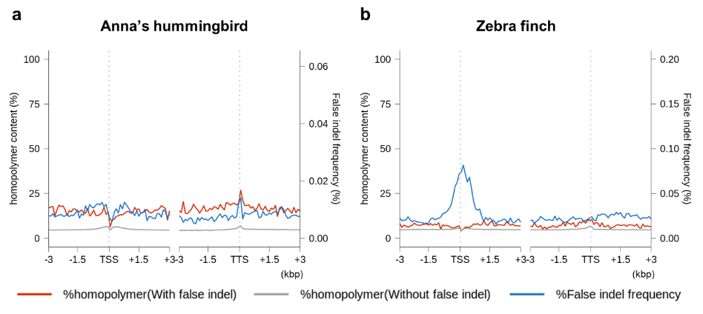
Chapter 2. False gene and chromosome losses affected by assembly and sequence errors
VGP
2.3.4. False SNP and indel sequence errors in GC-rich regions
Zebra finch & Anna’s hummingbird: Both VGP and prior assemblies were generated from the same individual
Collecting False SNP & Indel: Convert cactus alignment → variation graph (hal2vg) → Variant calling (vg deconstruct) → collecting SNPs and indels found in the prior assembly → Perform read mapping against reference assembly and extracted the coordinates of heterozygous or VGP erroneous regions → Filtered false SNPs and indels
Zebra finch (Sanger-based): Higher GC content in the regulatory regions or exons with false SNP or indel
Anna’s hummingbird (Illumina-based): Higher GC content with false SNP, but not for the false indel: mainly associated with % of homopolymeric sequences instead.
Summary of calling false SNP and indel from cactus alignment
Biased distribution of sequencing errors near GC-rich 5’-proximal regions of protein coding genes.
Homopolymer content and frequency of false indels near TSS and TTS.

Slide 23
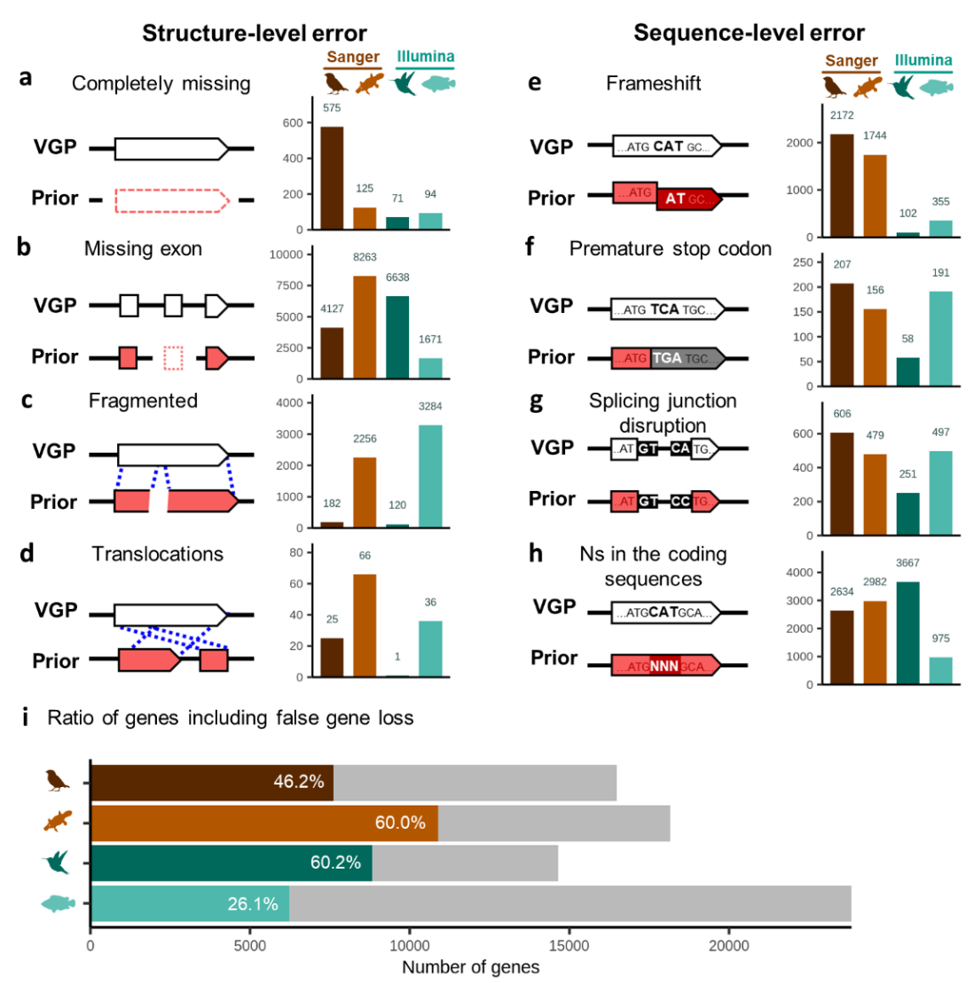
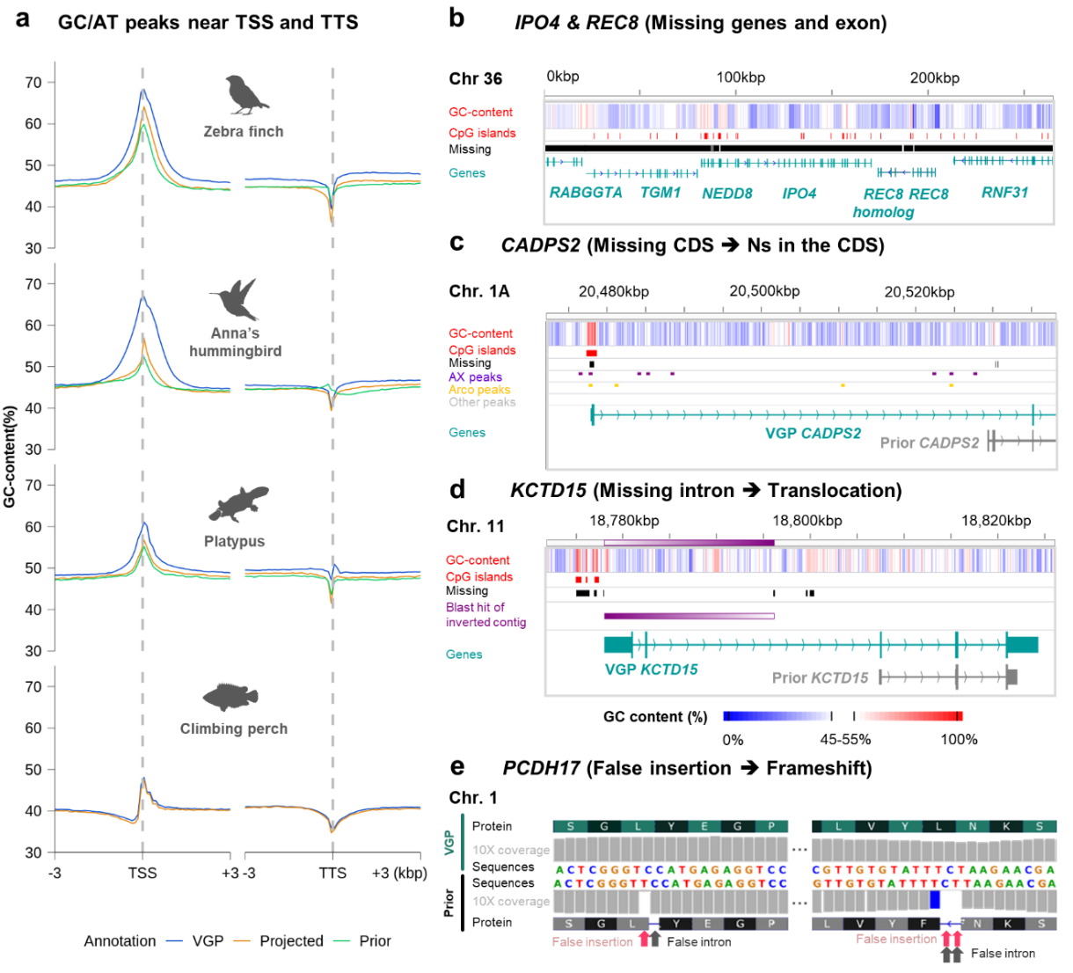
Chapter 2. False gene and chromosome losses affected by assembly and sequence errors
VGP
2.3.5. False gene losses in previous assemblies
- 26 ~ 60% of genes were previously affected by one or more types of false gene losses
It led to lower GC peaks near TSS in the prior annotation and lead to misunderstanding of several genes
Types and amount of false gene losses in the previous assemblies relative to the VGP assemblies.
Effect of false gene losses in the previous assemblies on annotations.

Slide 24
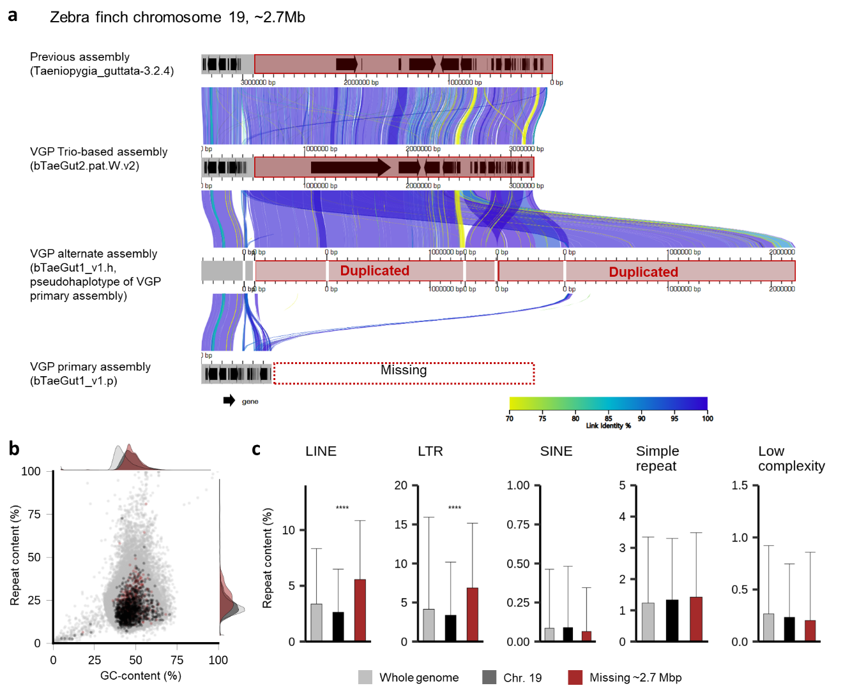
Chapter 2. False gene and chromosome losses affected by assembly and sequence errors
VGP
2.3.6. Example of genomic regions falsely missing in VGP assembly
Missing sequences in the VGP zebra finch assembly:
Chromosome 19: ~2.7 Mbp of its end sequences were missing in VGP primary assembly but assembled in the prior assembly.
No individual or haplotype differences: The same sample were used for both assemblies
False duplication: Missing sequences were falsely duplicated in VGP alternate assembly instead.
Enriched with repetitive sequences: Higher content of LINE and LTR repeats
Genomic regions that failed to be assembled in chromosome-level scaffolds of the VGP zebra finch primary assembly (bTaeGut1_v1.p).

Slide 25
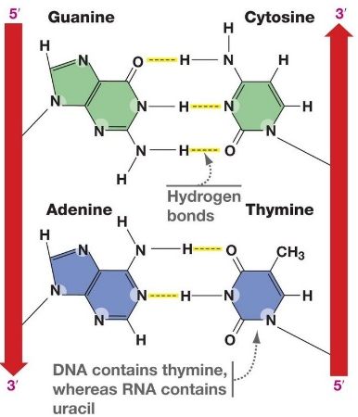
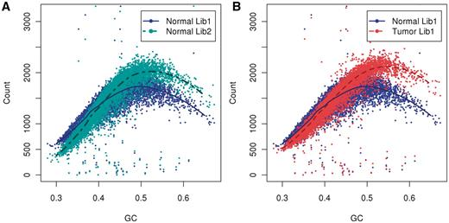
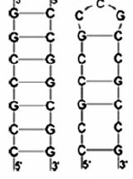
Chapter 2. False gene and chromosome losses affected by assembly and sequence errors
VGP
2.4. Discussion
Missing sequences in prior assemblies of the birds and platypus were associated with high GC content.
Biased GC content near TSS resulted in biased missing ratio and false sequence representation.
Substantial number of genes and even chromosomal segments were previously missing.
Errors in the prior assemblies indeed negatively affected their annotation as well, leading to incorrect gene structure prediction.
VGP assemblies successfully retrieve these missing sequences, but still include potential assembly errors as well.
1
2
3
1
2
GC bias in short-read length sequencing platform (Benjamini and Speed, 2012)
Formation of
secondary structures
More hydrogen bonds
in GC pairs than AT pairs
Benjamini, Y., & Speed, T. P. (2012). Summarizing and correcting the GC content bias in high-throughput sequencing. Nucleic acids research, 40(10), e72-e72.

Slide 26
Chapter 2. False gene and chromosome losses affected by assembly and sequence errors
VGP
To further improve
Limitation of species set:
analyzed the species within the VGP 1st release list (4 species with prior assemblies out of 14 species)
including other fish clades that were commonly used as reference (e.g. Tiger pufferfish)
Basic assumption: Are VGP assemblies always better than prior assemblies?
The assumption should have been examined first.
e.g. PacBio assembly includes lots of frameshift errors, VGP-specific duplication issues…
Annotation projection can be performed from the outgroup species.
Repeat content: How to define “repetitive sequences”?
Currently: using windowmasker masking information in the VGP sequences.
What about combining other repeat-masking tools with repeat databases (e.g. repeatmasker)?

Slide 27
Chapter 3. Genetic adaptations in mudskipper and tetrapod give insights into
their convergent water-to-land transition
This chapter was published in Animals as a partial fulfillment of Juwan Kim’s Master program.

Slide 28
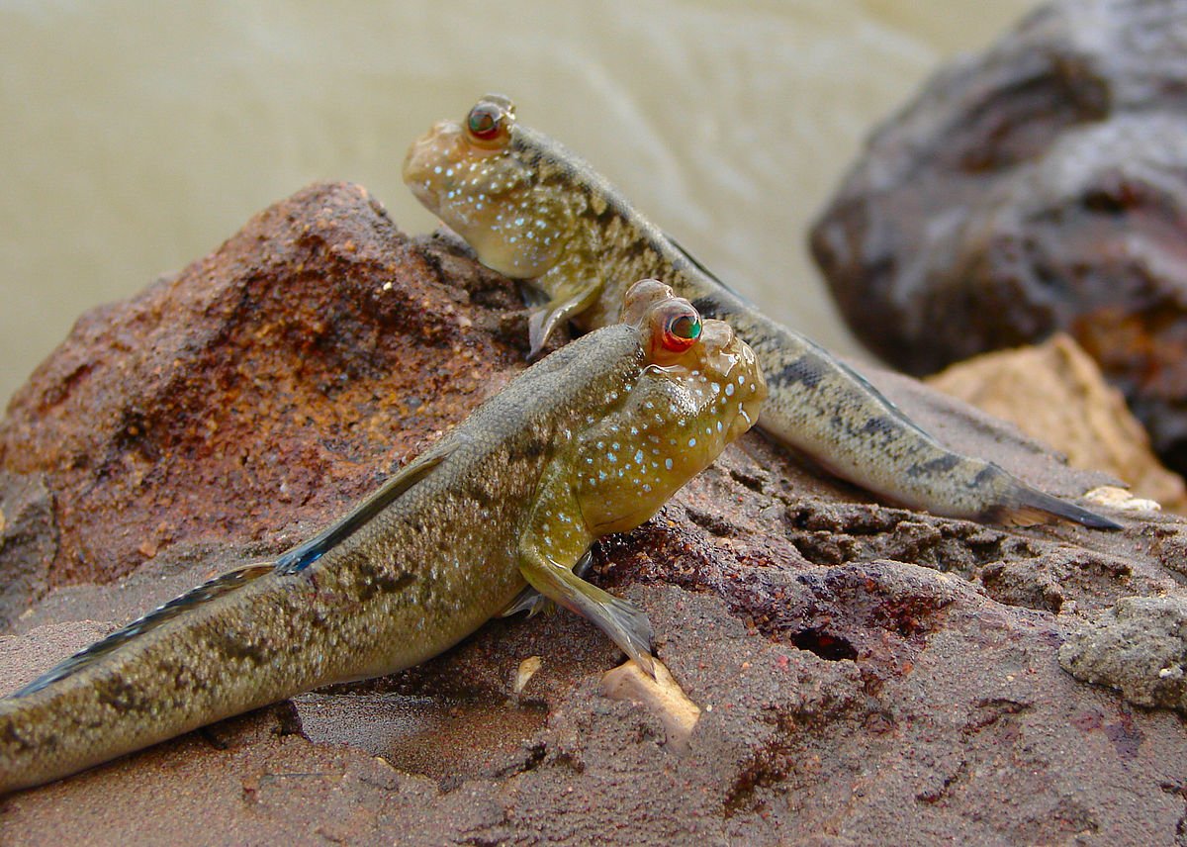
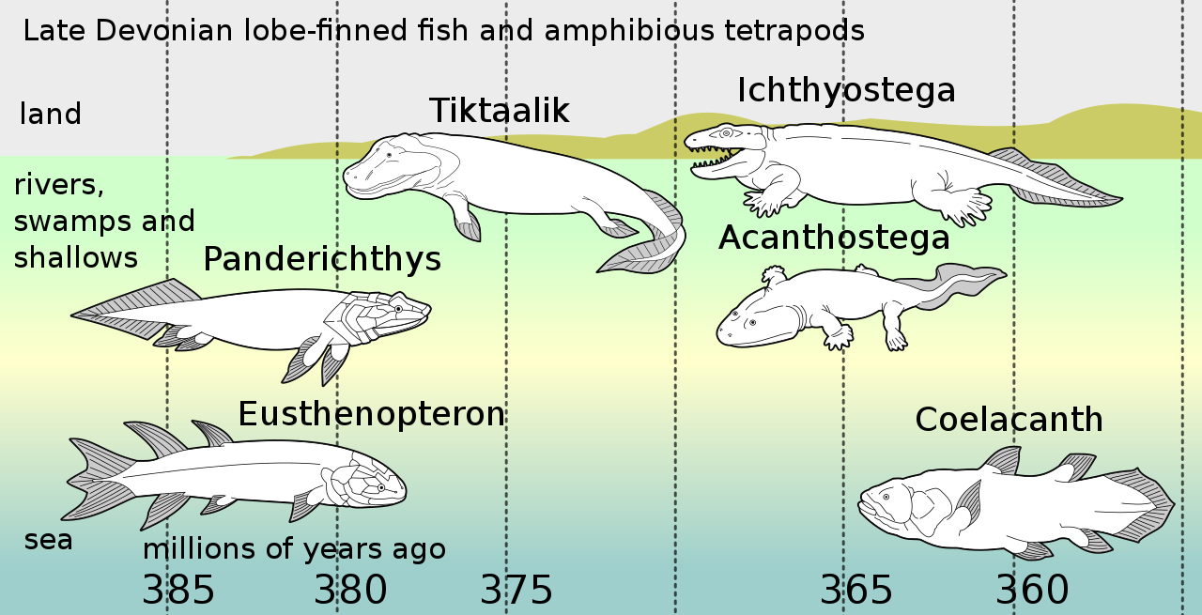
Chapter 3. Genetic adaptations in mudskipper and tetrapod give insights into their convergent water-to-land transition
3.1. Introduction
Water-to-land transition:
Definition: Macro-evolution of aquatic organisms adapting to the terrestrial environment
Example: Vertebrate land invasion in the Late Devonian Epoch, independently evolved in multiple lineages
Mudskipper: A model system of the vertebrate land invasion?
Land-adapting traits: The best land-adapting teleostean clade with unique characteristics:
Blinking eyes on the top of head
Terrestrial locomotion with highly modified pectoral fins
Bimodal respiration
Comparative genomics approaches to investigate the genetic adaptation of land-adapting vertebrates:
Positive selection detection: dN/dS (nonsynonymous substitution rates vs. synonymous substitution rates)
Amino acid substitution: TAAS (Target-specific amino acid substitution)
Gene family analysis: CAFE (Computational Analysis of gene Family Evolution)
CC BY-SA 4.0, Bjørn Christian Tørrissen
CC BY-SA 3.0, Dave Souza

Slide 29
Chapter 3. Genetic adaptations in mudskipper and tetrapod give insights into their convergent water-to-land transition
3.2. Materials and methods
Collection, alignment, and trimming of singleton orthologues:
Raw data: 12 species from Ensembl (Table 1, release 98)
Codon-wise alignment: prank (v.140603)
Codon-wise trimming: gblocks (v.0.91b)
Trimmed input data: 4,118 singleton orthlogues
Identification of positive selection related to water-to-land transition:
Phylogenetic tree: From TimeTree database & unrooted by ETE3
Positive selection signature detection: Branch-site test of CodeML
Criterion: ω2 > 1, 2∆L > 0, and FDR < 0.1
Detection of amino acid substitution under positive selection:
Positively selected sites: BEB > 0.95
Amino acids substitution: Performed by TAAS
Conserved domain search: NCBI conserved domain search (v.3.18) & UniProt
Detection of Rapidly Evolving Gene Families:
Representative transcript: longest transcript
Gene family analysis: CAFE (v.4.2.1)
Criterion: p-value < 0.05 for families
Species information used in this study
Scientific Name | Common Name | Taxon ID | Classification | Land adaptation | Ensembl Assembly
Periophthalmus magnuspinnatus | Giant-fin mudskipper | 409849 | infraclass Teleostei | O | PM.fa
Homo sapiens | Human | 9606 | superclass Tetrapoda | O | GRCh38.p13
Mus musculus | Mouse | 10090 | superclass Tetrapoda | O | GRCm38.p6
Bos taurus | Cattle | 9913 | superclass Tetrapoda | O | ARS-UCD1.2
Gallus gallus | Chicken | 9031 | superclass Tetrapoda | O | GRCg6a
Latimeria chalumnae | Coelacanth | 7897 | Non-tetrapod Sarcopterygii | X | LatCha1
Danio rerio | Zebrafish | 7955 | infraclass Teleostei | X | GRCz11
Astatotilapia calliptera | Eastern happy | 8154 | infraclass Teleostei | X | fAstCal1.2
Amphiprion percula | Orange clownfish | 161767 | infraclass Teleostei | X | Nemo_v1
Oryzias latipes | Japanese medaka | 8090 | infraclass Teleostei | X | ASM223471v1
Parambassis ranga | Indian glassy fish | 210632 | infraclass Teleostei | X | fParRan2.1
Poecilia formosa | Amazon molly | 48698 | infraclass Teleostei | X | Poecilia_formosa-5.1.2

Slide 30
3.3.1. Identifications and classifications of positively selected genes under different evolutionary models related to water-to-land transition
Chapter 3. Genetic adaptations in mudskipper and tetrapod give insights into their convergent water-to-land transition
(1) Three different models: Tetrapod model, mudskipper model, and tetrapod-and-mudskipper model
(2) Three different PSGs: Union PSGs, mudskipper-specific PSGs, and tetrapod-specific PSGs.
(3) Gene enrichment analyses on union PSGs: Several biological processes including “positive regulation of tumor necrosis factor production”, “mitochondrial gene expression”, and “metanephric glomerulus development”.
Different evolutionary models assuming positive selection on land-adapting lineages and the number of positively selected genes (PSGs).
Functional annotation of union PSGs. The gene ontology network was constructed by ClueGO with PSGs under FDR< 0.1, 2∆ L >0, and ω2 >1.

Slide 31
Chapter 3. Genetic adaptations in mudskipper and tetrapod give insights into their convergent water-to-land transition
3.3.2. Amino acid substitutions on the functional domains in union PSGs
Investigation of positively selected sites and Exclusive Amino Acid Substitutions under Positive Selection (EAASPS).
Genes involved in biological processes potentially associated with land adaptation:
Immune-response related: NOD1, ADCY7
Mitochondrial oxidative phosphorylation related: NOA1
Kidney development: LAMB2, KMO
Detection of exclusive amino acid substitutions under positive selection.
Positively selected amino acid substitutions in functional domains.

Slide 32
Chapter 3. Genetic adaptations in mudskipper and tetrapod give insights into their convergent water-to-land transition
3.3.3. Enrichment of DNA repair processes on tetrapod- and mudskipper-specific PSGs
Gene enrichment test with tetrapod-specific and mudskipper-specific PSGs:
“DNA repair” and “negative regulation of double-strand DNA repair” related terms.
Protein-protein interaction analyses:
Tetrapod- and mudskipper-specific PSGs involved in “DNA repair” related GO group
5 tetrapod-specific PSGs and 1 mudskipper-specific PSGs involved in “response to UV”
Associated with extended UV exposures on land environment?
(You et al., 2014)
Protein-protein interaction network between tetrapod-specific and mudskipper-specific PSGs involved in “DNA repair”.
Protein-protein interaction network between tetrapod-specific and mudskipper-specific PSGs involved in “response to UV”.
You, X., Bian, C., Zan, Q., Xu, X., Liu, X., Chen, J., ... & Shi, Q. (2014). Mudskipper genomes provide insights into the terrestrial adaptation of amphibious fishes. Nature communications, 5(1), 1-8.

Slide 33
Chapter 3. Genetic adaptations in mudskipper and tetrapod give insights into their convergent water-to-land transition
3.3.4. Convergent contraction of βγ-crystallin gene superfamily in land-adapting species
Convergent rapid contraction of gene families in land-adapting lineages: Eight gene families including βγ-crystallin gene superfamily
(2) Synteny analysis of contracted βγ-crystallin gene superfamily: Contraction of γ-crystallin genes supported by syntenic evidences in both mouse (land-adapting tetrapod) and mudskipper (land-adapting fish).
Rapidly evolving gene families in mudskipper and tetrapod ancestor lineages.
Synteny near the βγ-crystallin coding genes that were contracted in terrestrial vertebrates.

Slide 34
Chapter 3. Genetic adaptations in mudskipper and tetrapod give insights into their convergent water-to-land transition
3.4. Discussion
Importance of immune response related to land adaptation: NOD1 gene
Land environment: likely to be exposed to novel pathogens including bacteria
NOD1: recognizes the bacterial LPS (lipopolysaccharide), thus activates NF-κB signal pathway and promotes the expression of inflammatory cytokines
Oxidative phosphorylation & Kidney development
- Oxygen: a terminal electron acceptor in mitochondrial oxidative phosphorylaiton
Kidney: retaining water and salt, and thus acts as a osmoregulator
Contraction of γ-crystallin gene family
Contraction of γM-crystallin: already reported in terrestrial vertebrates (soften their aquatic lenses and reduce the refractive index to obtain aerial vision that could focus at a distance) (Wistow, 1993)
Might be related to mudskipper’s aerial vision as well?
Wistow, G. (1993). Lens crystallins: gene recruitment and evolutionary dynamism. Trends in biochemical sciences, 18(8), 301-306.

Slide 35
Chapter 3. Genetic adaptations in mudskipper and tetrapod give insights into their convergent water-to-land transition
To further improve
Improving genome assembly quality:
- Including the species with more continuous assemblies (e.g. from VGP) would enhance the strength of this study.
Design of species set
Genome assemblies of other aquatic gobies would help us to further exclude the evolutionary signatures specific to gobies (thus, not likely to be involved in the land adaptation).
Including amphibian species and more diverse tetrapods might improve the quality of this study as well.
Performing dN/dS analysis between evolutionarily distant species
Currently, no alternative methods for the positive selection signature detection.
Limitation to check the biological interpretation
Experimental validation including RNA-seq, reference-quality genome sequences of other mudskippers or closely related species, search of gene loss, and validation of functional changes of protein products

Slide 36
General discussion

Slide 37
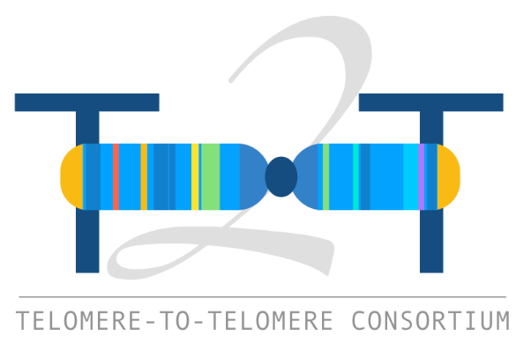
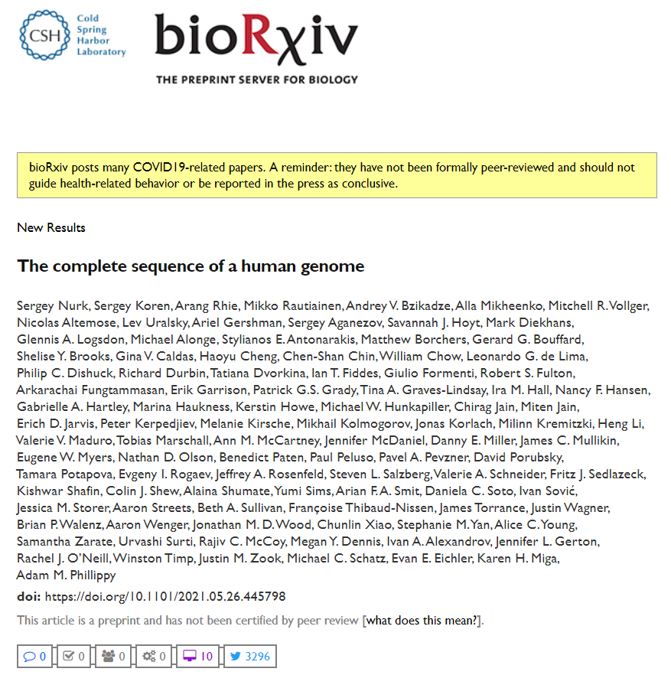
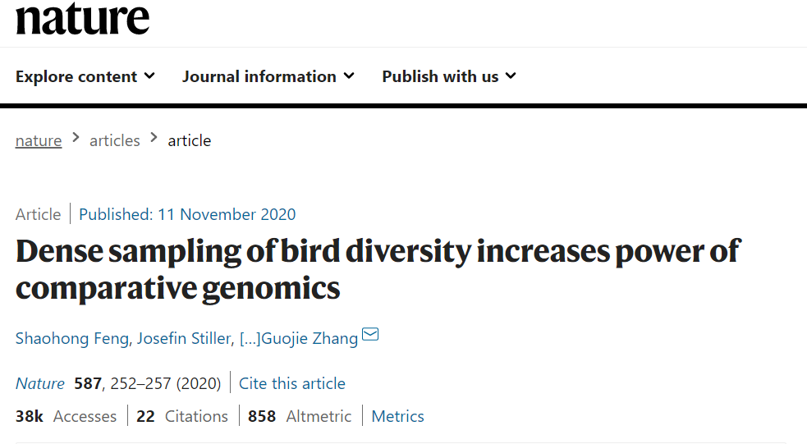
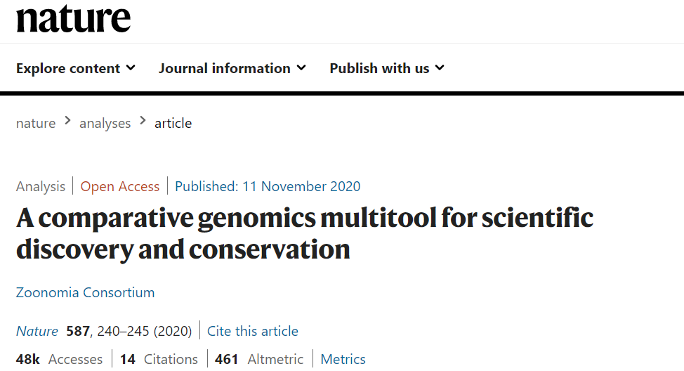
General discussion
General discussion
Recent production of “complete genome” of a human (“The complete sequence of a human genome”)
- Based on CHM13 hTERT cell lines (nearly homozygous): currently not applicable for all vertebrates
However, still necessary to produce “complete genome” of the species with historical genome assemblies to keep evaluating impacts of assembly quality improvements
Recent release of hal alignment with hundreds of vertebrate genomes (e.g. Zoonomia)
Providing great opportunities for various comparative genomics analysis

Slide 38
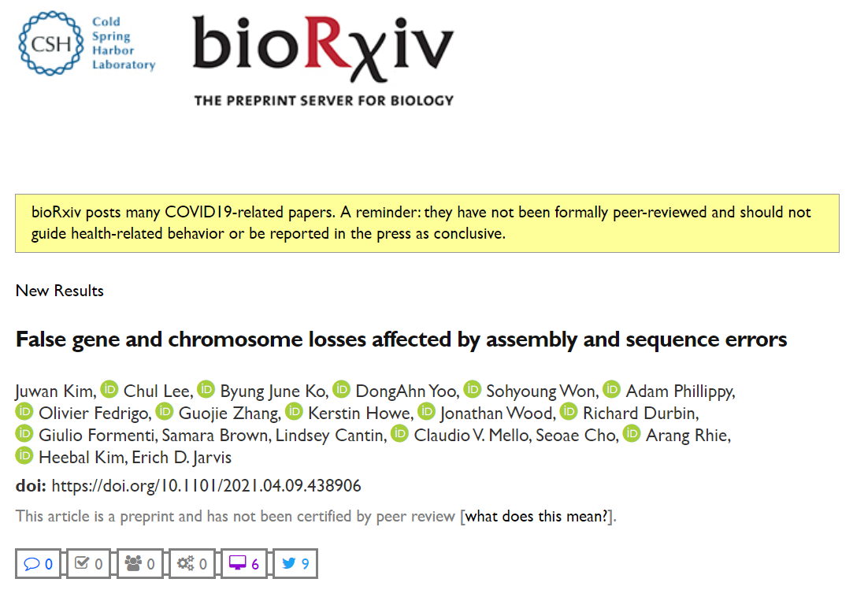
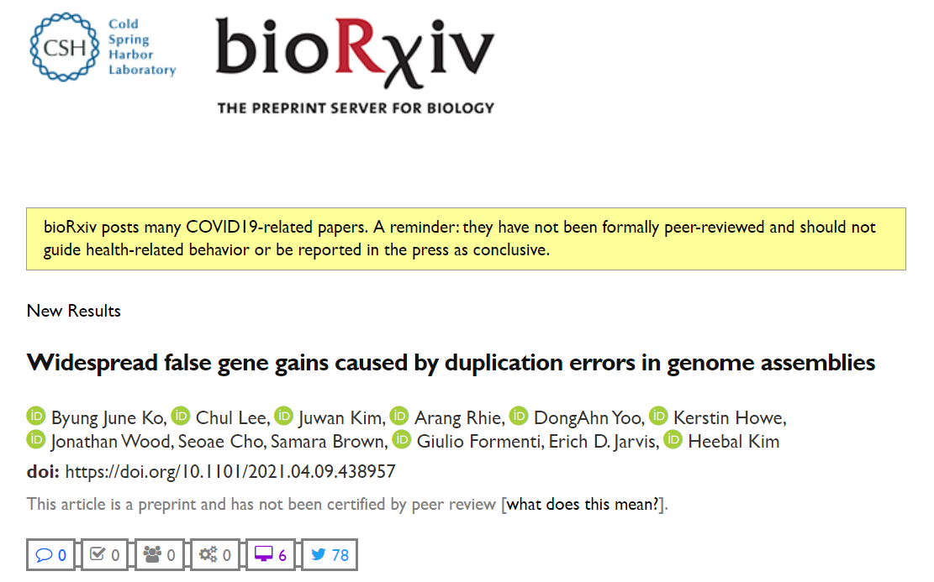


Publications
Accepted
Juwan Kim, Chul Lee, DongAhn Yoo & Heebal Kim (2021). Genetic Adaptations in Mudskipper and Tetrapod Give Insights into Their Convergent Water-to-Land Transition. Animals, 11(2), 584.
Arang Rhie, Shane A. McCarthy, Olivier Fedrigo, Joana Damas, Giulio Formenti, Sergey Koren, Marcela Uliano-Silva, William Chow, Arkarachai Fungtammasan, Juwan Kim, …, Kerstin Howe, Eugene W. Myers, Richard Durbin, Adam M. Phillippy & Erich D. Jarvis (2021). Towards complete and error-free genome assemblies of all vertebrate species. Nature, 592(7856), 737-746.
In preparation (preprint)
Juwan Kim, Chul Lee, Byung June Ko, DongAhn Yoo, Sohyoung Won, Adam Phillippy, Olivier Fedrigo, Guojie Zhang, Kerstin Howe, Jonathan Wood, Richard Durbin, Giulio Formenti, Samara Brown, Lindsey Cantin, Claudio V. Mello, Seoae Cho, Arang Rhie, Heebal Kim & Erich D. Jarvis (2021). False gene and chromosome losses affected by assembly and sequence errors. bioRxiv. (→ will be submitted in genome biology)
Byung June Ko, Chul Lee, Juwan Kim, Arang Rhie, DongAhn Yoo, Kerstin Howe, Jonathan Wood, Seoae Cho, Samara Brown, Giulio Formenti, Erich D. Jarvis, Heebal Kim (2021). Widespread false gene gains caused by duplication errors in genome assemblies. bioRxiv. (→ will be submitted in genome biology)

Slide 39

Acknowledgement
I would like to express my great appreciation to professor Heebal Kim and all the members of BIOPOP.

Slide 40
석사학위논문심사 발표자료
Thank you for listening!
BIOPOP: Lab. of Bioinformatics and Population Genetics

